Slide 1
File System and I/O
Operating System Lab-in-a-Box
Notes:
In this module we learn about the file system and input and output

Slide 2
Previous
Virtual Memory
Notes:
In the previous module we learnt about “Virtual memory”.

Slide 3
Current Module
Extended data Storage and File System
File structure and directory structure
File attributes
Open Files
Allocation methods
Accessing a file, disk
Disk and I/O scheduling
I/O, Direct control
Interrupt and
DMA
Notes:
In the previous module we learnt about “Virtual memory”. In this module we learn the above topics mentioned in the slide.

Slide 4
The Extended Data Storage
File System and I/O can be both considered as extensions to the memory hierarchy
In a users’ perspective, the most visible components
File - a chunk of relevant data, organized according to either users or applications, usually contiguous in logical address space.
OS needs to manage files and provides interface to users so that they can read/write…
Luxury to embedded applications, but nowadays not uncommon!
Input, output devices – peripherals. In embedded system, could be on-board or external
OS has to unify data representation
“Everything is a file.”
Notes:
Technically, peripherals also include storage devices such as hard drives, flash drivers, etc. File systems and I/O devices look like a memory location most of the time and look like a part of memory hierarchy. Files are a group of data stored in contiguous logical address space (not necessarily contiguous physical address space). The operating system provides support for reading or writing into a file or an I/O device.

Slide 5
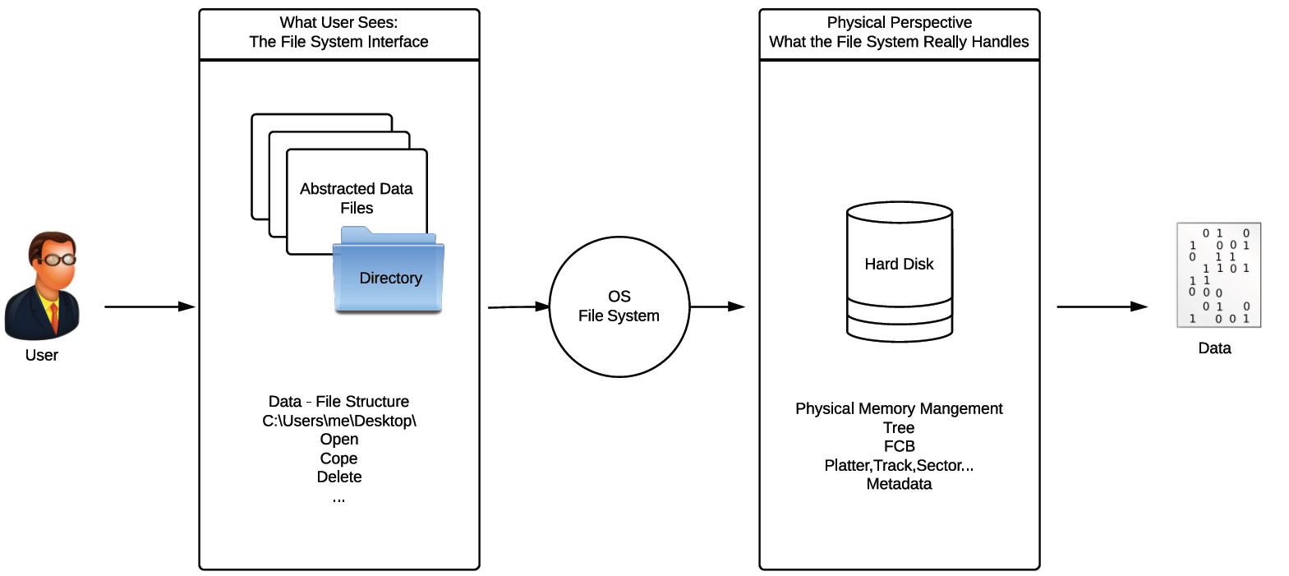
File System
The file system is all about how to organize and present data so that user can have easy access.
Notes:
As the above picture shows, the file system is managed by the operating system so that a user can have easy access to it.
What the user sees is the file system interface. The files are in the physical memory in locations managed by the OS.

Slide 6
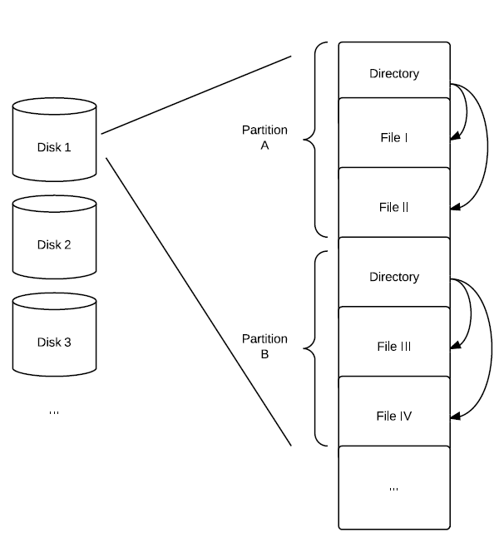
File Structure
Disk
Partition (C drive)
Multiple partitions on one disk
One partition on multiple disks
A logical(virtual) hard disk
Directory
Data structures maintained by the OS to keep track of files.
Also keeps file attributes and metadata
Both directories and files are stored on the disk
File
Notes:
Files have multiple pages and there are multiple files per user. There can be multiple partitions on one disk or one partition on multiple disks. Data structures maintained by the operating system keep track of files and keep the files attributes in a directory; both directories and files are stored on the disk.

Slide 7
Directory Structure
Single-Level Directory
Ancient structure, everything in the same directory and memory loads the directory to a fixed location to support file operations.
No same name files allowed
No path
Two-Level Directory
Main file directory and user file directory
To individual user, equivalent to single-level directory
Tree-Structured Directory
The concept of (relative, absolute) path and working directory
Notes:
Directory structures can be single level, two-level or tree-structured.
In a single level directory - all files are in one directory.
In a two-level directory - there is a main directory and user directory. Each user has a directory as a single-level directory.
In a tree-structured directory, the concepts of a path and working directory are present.

Slide 8
File
Counterpart of a real document in a computer, thus the name (similarly for directory)
In brief, a collection of related data (could also be program codes) represented as a block in a contiguous logical address space plus associative information
Can be further divided into records and fields…
Two types:
No structure: streams of bytes
Easy to handle and modified
But hard to search for specific unit
Windows, Unix
Structural: either records or formatted documents; could be variable length
Clear logical organization, easy to modified, search and manage on the record level
Complicated
Not mutually exclusive, OS can support both
Notes:
Files are data/program represented as a block in a contiguous logical address (not physical address). These files can be divided into records and fields.
There are two types of files: Non-structured and structured. Non-structured files are simply bytes of data and they are easy to handle, but difficult to search for a specific unit of data.
A structured file has a logical organization. It is easy to modify, search and manage at the record level. However, it is complicated compared to a non-structured file.
Both structured and non-structured files can exist and the operating system can support both.

Slide 9
File Attributes
The “associative information”
Name
ID
Size
Type
Creation/Modified Date
Permission/Protection – access control, which group of user can perform what operations?
Location – where is it based in the hard disk?
Directory information
File Control Block (FCB)
Notes:
Some modern embedded systems, even though equipped with file systems, do not support directories. These are “Flat” file structures. File attributes include: Name, ID, size, type, creation . Modified date, permission/protection, location and directory information. There will also be a file control block.

Slide 10
Open Files
A file can usually be opened by multiple processes, unless otherwise specified by open file locking
Two file tables
Public file table maintained by OS and is independent of processes
Location on the disk, access time, size and so on
File open counter, if can be reopened, this is to count the number of times the file is opened
Access rights
Process dependent table, unique to the process and keep tracks of all files that is currently accessed by the process.
File pointer, points to recently read/write location
Pointer to the entry in the public file table
Notes:
In general, a file can be opened by more than one process. There will be two file tables – a public file table (maintained by the OS) and a process dependent table (one for each process)

Slide 11
Allocation Methods
Contiguous Allocation
Simple to implement as only the start and size of the file are needed
Support Random Access
But waste space and cannot deal with variable size
How to delete? Insert? – Frequently modified files will have troubles
Linked Allocation
Linked list, current block will points to the next block
Highly flexible in terms of saving memory space
However, can only access in the right sequence
Indexed Allocation (Could also be multilevel)
Flexible and dynamic, support variable size file and random access
Memory overhead and have to access disk at least two times
Cache some of the index table to improve performance
Bitmap is also a generic method widely used to manage free spaces
Notes:
File allocation methods are:
Contiguous
Linked
Indexed
Bitmap
Contiguous allocation is simple, it supports random access, but wastes space. Frequently modified files will have trouble with deleting and insertion.
In linked allocation, the operating system maintains a linked list (current block points to the next) of the blocks in memory. It is highly flexible and saves memory, however, one can only access data in the right sequence, i.e. must go from the start of the list to reach a block later on in it.
Indexed allocation is flexible, dynamic and supports variable size files and gives random access. A memory overhead is present since index information also needs to be stored.
Bit map is also a popular method.

Slide 12
Accessing A File
Modify, append or search (inside the file) - read/write
Access methods
Sequential – heritage of tape file system
Read/write next
Reset
Skip forward/backward
Direct/Relative/Random – more hard disk
Read/Write n
Index – fast for search and database
Notes:
Users will like to modify, append or search a file. The access methods for a file are:
Sequential
Direct/relative/random
Index

Slide 13
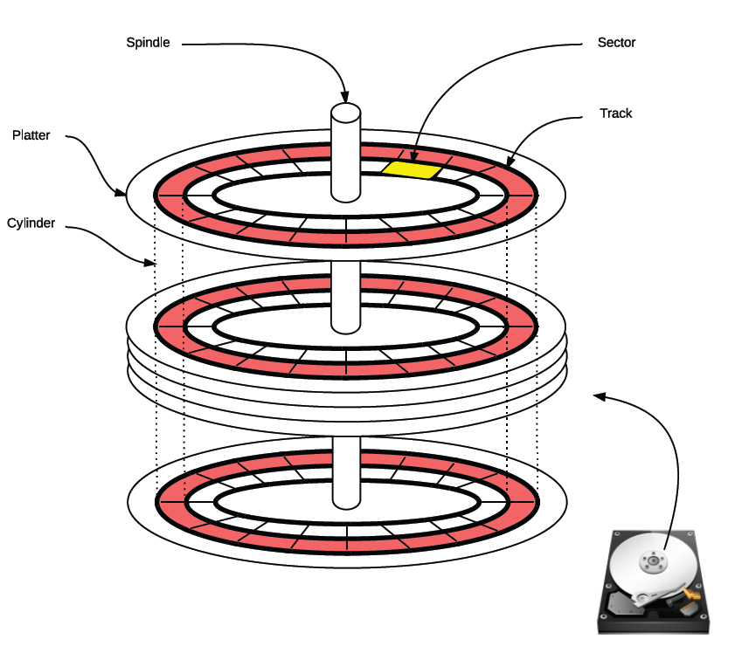
Disk
Logical file will be eventually mapped to a section in the disk
Virtual Cylinder-head-sector (CHS)
To find the target sector
Mechanically move the head to the correct cylinder
Rotate the spindle and wait until the correct sector
Disk Scheduling
To reduce latency
Assume random access
Notes:
The head is not drawn in the larger figure, but can be seen in the smaller disk icon.
The hard disk consists of multiple platters, each of which is divided into tracks. There are nearly a thousand tracks on a 3.5 inch hard disk. The tracks are subdivided into sectors of size 512 bytes.
A group of tracks with the same track number, on different platters, is a cylinder. There are normally 1024 tracks on a hard disk.
Files are stored in a single contiguous area of disk space.
Logical files will be mapped to a section in the disk, virtual cylinder-head-sector.
To find a target sector, mechanically move the head to the correct cylinder and rotate the spindle till the correct sector.
Disk scheduling is done to reduce latency and gives almost a random access. Disk scheduling algorithms are used to reduce the total seek time of any file/data.

Slide 14
Disk Scheduling Or I/O Scheduling
We have already introduced some scheduling techniques, possible to use them here
Random Scheduling (RSS), FIFO, LIFO, shortest seek first
Elevator algorithm: or SCAN, move the head in only one direction and stop if any request for the current cylinder (utilize locality?)
Circular Scan: the circular variant of the elevator algorithm
What if request of the current cylinder keep coming? – stiff arm (starvation)
N-Step-Scan: queues are consists of several sub-queues (elevator algorithm) of N request. New request won’t affect the head if the queue is already long enough
FSCAN: two queues, during the current scan cycle, all new requests are pushed to the other queue.
Notes:
Disk Scheduling Algorithms are used to reduce the total seek time of any file/data.
Some of the algorithms are:
RSS, Random scheduling
FIFO, First in First out scheduling
LIFO, last in first out scheduling
Shortest Seek first scheduling
Elevator Algorithm (or SCAN)- move the head in one direction till the end (like an elevator)
Circular SCAN– variation of the elevator algorithm
N-Step-Scan scheduling
FSCAN Scheduling

Slide 15
I/O
A wide range of devices. Unity is nowhere from achievable
An example – Mouse
How many buttons? Two plus a scroll wheel? (Check Razer mice)
Communication protocols?
PS/2
USB
Wireless
…
Drivers?
There are four major approaches to handle I/O devices:
Polled (direct control by the CPU)
Interrupt
DMA
I/O channel
Notes:
There are many Input/Output devices to computers. Input devices include: keyboard, mouse, touch pads, joy stick, etc. Output devices include monitors, printers, etc. Communication devices include network card, wireless card, etc.
Each of these I/O devices is a different type. They all behave slightly differently. We need specific device driver software to interface with them.
There are four methods to handle I/O devices:
Polled (direct control by the CPU)
Interrupt
DMA
I/O channel

Slide 16
Direct Control
On-board peripherals – write/read configuration register is a standard practice
Polling?
void main(){
while(check_IO_status ()){
…...
}
}
Busy waiting until I/O finishes
Simple but a wasteful of CPU
Notes:
Polling is a popular method for I/O control.
Here, the CPU waits for the I/O device to indicate that it is ready. It is a busy wait process. It is simple, but wastes CPU time.

Slide 17
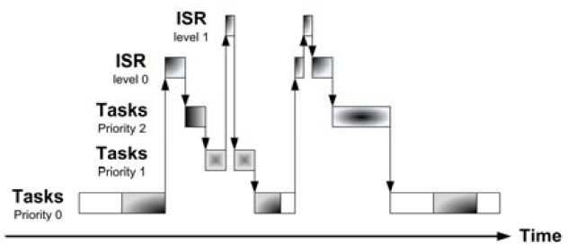
Interrupt
I/O will notify the CPU when its job is done. Then the interrupt service routine (ISR, or handler), a piece of (usually short) code is triggered to deal with the I/O.
Fundamental mechanism of microcontrollers
Provides efficient event-based processing rather than polling
Provides quick response to events regardless* of program state, complexity, location
Allows many multithreaded embedded systems to be responsive without an operating system (specifically task scheduler)
Priorities
Nested interrupts
Notes:
It is assumed that students are somehow familiar with interrupts.
Interrupts are signals from the I/O device to notify the CPU to initiate actions related to the I/O device. The CPU stops the program it is running when interrupted, saves the current state in the stack, jumps to the interrupt service routine and executes the code (thus servicing the I/O device). If there are multiple interrupts, they can be handled based on the priority of the interrupt.
Sometimes nested interrupts are allowed. Nested interrupt means one interrupt service routine gets interrupted in the middle and it enters the same interrupt service routine again for another operation.

Slide 18
Interrupt
Interrupt improves the performance of the CPU in many ways compared to polling. However, the overhead of interrupt may scale up as the number of peripherals increases.
Interruptions could also lead to unpredictable and unstable CPU states. Which is generally undesirable for real-time systems.
Although RTX supports Cortex-M interrupts, interrupts are usually only used to set event flags
Notes:
It is assumed that students are somehow familiar with interrupts.
Interrupts provide better I/O response times than polling. However, the overhead of interrupts may scale up as the number of peripherals increases.
Interruptions could also lead to unpredictable and unstable CPU states, (due to limited stack memory space and repeated nested interrupts).
Although RTX supports Cortex-M interrupts, interrupts are usually only used to set event flags.

Slide 19
Interrupt Example For Discovery
void Init_Switch(void){
RCC->AHB1ENR|=RCC_AHB1ENR_GPIOAEN;
GPIOA->PUPDR|=GPIO_PUPDR_PUPDR3_0;
//Connect the portA pin3 to external interrupt line3
SYSCFG>EXTICR[0]&=SYSCFG_EXTICR1_EXTI3_PA;
//Interrupt Mask
EXTI->IMR |= (1<<3);
//Falling trigger selection
EXTI->FTSR|= (1<<3);
__enable_irq();
NVIC_SetPriority(EXTI3_IRQn,0);
NVIC_ClearPendingIRQ(EXTI3_IRQn);
NVIC_EnableIRQ(EXTI3_IRQn);
}
void EXTI3_IRQHandler(void){
//Clear the EXTI pending bits
EXTI->PR|=(1<<3);
NVIC_ClearPendingIRQ(EXTI3_IRQn);
//…Handle the IO here
}
Notes:
An interrupt example is given in this slide.

Slide 20
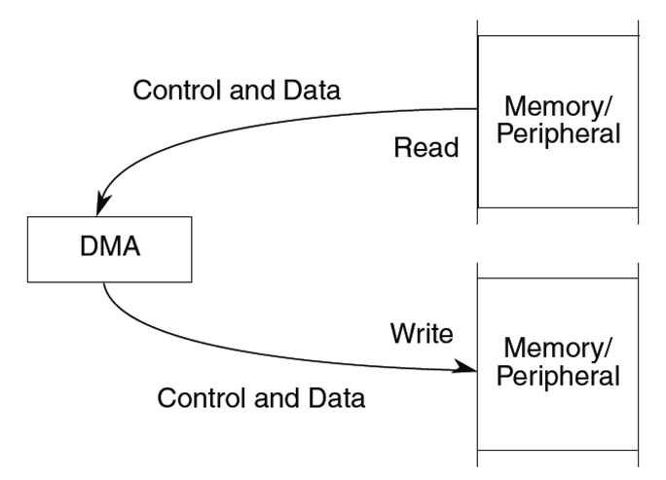
DMA
Direct Memory Access - Special hardware to read data from a source and write it to a destination
All the CPU needs to do is configure it correctly
Various configurable options
Number of data items to copy
Source and destination addresses can be fixed or change (e.g. increment, decrement)
Size of data item
When transfer starts
Can also work with interrupts, e.g. interrupt CPU at the end of a transfer
Exempt the CPU from busy-waiting and frequent interruptions.
Notes:
Direct Memory Access is a hardware unit, which works in parallel with CPU and handles the I/O operations. The CPU configures the DMA chip and initiates the data transfer from peripheral to memory or vice versa.
Various configurable options:
Number of data items to copy
Source and destination addresses can be fixed or change (e.g. increment, decrement)
Size of data item
When transfer starts
DMA can interrupt the CPU at the end of data transfer.
CPU can do useful work when I/O data transfer is monitored by DMA.

Slide 21
I/O Channels
A separate processor specialised for I/O control
May have own specific instructions
Share memory with CPU through bus (steal cycles)
Individual programs on memory and could be dynamically generated
Further minimizes CPU intervention
Notes:
I/O Channels or I/O processors can handle I/O operations and free the CPU. The I/O processor can share memory with the CPU but the CPU need not intervene with I/O processor for data transfer to I/O.

Slide 22
Next
RTX Case Study
Notes:
The next module will cover RTX real time operating system.

